Slide 1
E-Documents
Warning:
The product presented further in this document is proof of concept (PoC further in document) and is lacking design, some useful features and may require other changes before actual implementation.
Go to this slide to see what is required\suggested for implementation in the product during further development. Or simply follow the document.
If you already watched the presentation, you can go directly to PoC right here.
MS PowerPoint version can be downloaded here.

Slide 2
Current system
E-Mail
Source Systems
Network drive(s)
Local file generation system
Clients
Download website
Click on the element to see more details
As result of all mentioned deficiencies – not so happy clients.
Click me to see how to make me happy

Slide 3
Source systems
Currently following systems are used:
System for statements
System for orders 1
System for orders 2
System for orders n
Deficiencies:
Every system has unique format for each document (no standardization, generation system’s logic complication)
Adding new report will complicate generation system’s logic even more slowing down import process
Back to main slide

Slide 4
Network drive(s)
Handoffs from source systems are stored on network drives as physical files. Handoffs may be generated in human-ready format, instead of machine-ready format
Advantages:
Additional checkpoint
Ready-to-print (no secondary software is required)
Deficiencies:
More time wasted on file generation
More time wasted on file transfer
More time wasted on file import
Works only in “batch” mode (offline mode, only by specific schedule)
Insecure: files can be tempered with before being imported
Back to main slide

Slide 5
Generation system
Local application, that imports handoffs from source systems (by parsing them), converts them to HTML format, then to PDF and prepares .zip files, that are later sent to clients.
GUI based application, but GUI capabilities are very limited and sometimes non-intuitive.
Advantages:
Centralized (from local branch(es)’s POV)
Easy print-out or re-transfer
Deficiencies:
Extra dependencies on client workstations: Internet Explorer, Outlook, CryptoPRO or other encryption software, local resources
Need to convert text to HTML first (significantly increased generation time (estimate of 2+ hours))
Some operations and modules are very inflexible
Limited storage due to huge overall size(on database level)
Potentially inflexible access permissions: some permissions may be given to users, that do not use them
Back to main slide

Slide 6
E-Mail
Some branches that work in different time zones require the data to be retrieved sooner than Moscow branch. For this e-mails with client data is sent to them
Advantages:
Secure (where CryptoPRO is used)
Generally faster delivery (fewer data to send, which is sent at first steps of transfer)
Deficiencies:
Not so secure (where password protected .zip files are used)
Dependencies on Outlook on client machine
Dependencies on CryptoPRO or other encryption software on client machine
Dependencies on local application(s)
Back to main slide

Slide 7
Download website
Module of a global/regional system. Primary used by clients to download electronic documents in different formats (not only from generation system in scope of this document, but from other local and regional systems, as well) and upload specific documents of their own
Advantages:
Centralized (from regional POV)
Web-based and thus usable from anywhere in the world (theoretically through mobile devices as well)
Deficiencies:
Old hardware
Downloading a file more than 100 Mb can (and usually will) downgrade general server performance and may result in a file being downloaded corrupted or not being downloaded at all
Non-user-friendly and non-intuitive interface
Storage of files only for 2 month due to huge overall size
Back to main slide

Slide 8
Suggested system (simplified view)
Source Systems
Database(s)
Web GUI
Clients
File Storage
Click on the element to see more details
As a result - happy clients
Click me to see how company becomes happy as well

Slide 9
Source systems
Any local or regional system dependent on the branch
Following ways of data transfer can be used:
Data transfer type | Advantages | Disadvantages
Direct Database Connection (ODBC) | No handoff files required Quick transfer of the data Secure transfer (stream transfer hard to intercept) | Batch transfer only (online connection possible, but not recommended) Relatively insecure connection (access given to table, but not to specific columns) Source and destination databases preferably should be the same type (e.g Oracle->MSSQL complicates system)
IBM MQ | Secure Strategic Online (optional) Generally fast System independent | Expensive Difficult (and expensive) maintenance Handoff files are to be used (standardization required)
Machine-ready handoffs | Cheap System independent | Handoffs files are to be used (standardization required) Generally slower transfer rate compared to above Batch transfer only (no online connection)
Back to main slide

Slide 10
Databases(s)
Settings database stores data used to identify users in WebGUI and provide them necessary data compliant with their permissions. Can be used to setup “client” (Cclient in PoC) access and “manager” (Pclient in PoC) access, which allows clients to safely manage overall access provided by company’s operators (Ops in PoC), minimizing time consumption on provider’s side
Pclients can create both other Pclients (useful for branched organizations) and Cclients alike. Child Pclients will be able to create Cclients only with access rights available to them or less
“Quick-Access” stores data for last month (or week), which is available for “quick” correction in case of any issues on the side of the branch
Settings database
“Quick-Access” database
Source systems
Web
GUI
“Quick-Access” database should be considered optional
Archive database
Archive database stores data for periods older than data in “Quick-Access” (up to 11 years for Russia as per law). Data from “Quick-Access” is dumped weekly\monthly by operator
Both databases are stored on branch level, but are standardized as much as possible
Back to main slide

Slide 11
Web GUI
Some modules are not yet implemented in PoC. Some modules are optional, but are highly advisable. Click here for samples and some more explanations on backend.
Suggested main modules (click for details)
Optional service modules (click for details)
Documents generation
Document upload
Settings system
Feedback system
Info
system
Filter page, where client chooses type of electronic document, date period, account and other (mainly optional) parameters to get desired document(s). Then the document(s) is generated by taking data from database(s) after checking user permissions for the documents requested. Document(s) output in .pdf inside the browser or via a link for big files
Page with ability of file upload. Preferably just one field where user chooses a file. And then the system should parse it and if it’s an acceptable document – send it to database (actually store it on File System, but have a reference in Database). Alternatively – use separate field to select file type.
User also should have access to files he uploaded before with statistics (time, file type, size, processed by company or not, .etc)
Page with ability to fine-tune user settings (web-page layout, security settings, notifications, .etc).
Pclients and Ops should have access to other users’ settings as well, with ability to freeze settings (prevent changes by user)
Page with ability to fill-in feedback form to send feedback to administration.
Possibly some kind of a mini-forum, where clients can interact with each other as well, discuss advantages and disadvantages of company in general and E-Documents system in particular and, maybe, even get responses from company’s employees (functionality should be close to that of vBulletin)
Company’s news. News submitted by the clients about the clients (for extra fee? Blog style?). Ability to make “personal page” for the client (extra fee?) visible by other users (as advertisement and\or statistics). If vBulletin is used both CMS and Blogs functionality can be used
Back to main slide
Company Admins
All of the above with some extra access to user settings (including creation), feedbacks and statistics

Slide 12
File Storage
A storage server, used for temporary storage of files uploaded by users. User uploads a file, which is saved to appropriate folder on storage server. Statistics should be provided to clients. Clients should have ability to remove files recently uploaded (up to several days old). Admins should have ability to remove any selected file with automated notification sent out to client who uploaded the file (if client is in database and enabled)
After initial upload basic statistics can be added to database for client and company’s Admins to see in future through WebGUI.
Same storage can be used to deliver large files to clients. Should be able to be generated and downloaded by client by using an API or a small application with auto-login function through command line.
Back to main slide

Slide 13
Technologies required
Visual C++ Redistributable x86/x64 (pre-requisite)
Apache HTTPD server 2.4.9 x64 or newer (hosting)
PHP 5.6.0b4 x64 or newer (parser for scripting language)
JavaScript (some features of GUI and backend functions for security purposes)
MySQL 5.7.4m14 x64 or newer (database storage; other storages are possible)
Mod_security 2.8.0 x64 or newer (security for hosting server)
Mod_evasive (DoS protection for hosting server)
OpenSSL 1.0.1h (for key and certificate generation; other similar software can be used)
TCPDF (for dynamic .pdf files generation)
vBulletin (for forums; optional; other forum engines can be used)
phpMyAdmin (for database management; optional; other software (including native one) can be used)
Notice: above technologies were used in PoC. Alternatives can be used if desired, but may require significant changes in the code.
Back to main slide
Permissions

Slide 14
Permissions
Sample of basic permissions provided to users by group. May be changed and\or extended during development and may differ from actual current permissions setup. This is to provide general direction of roles segregation.
 | IsAdmin | IsISA | IsOps | IsPClient | IsCClient
Create admins | Yes | Yes | No | No | No
Create ISA | Yes | Yes | No | No | No
Create Ops | No | Yes | No | No | No
Create Pclient | No | No | Yes | Yes | No
Create Cclient | No | No | No | Yes | No
Search for corrupt rights | Yes | Yes | No | No | No
See strikes fo all users | Yes | Yes | No | No | No
Clear strikes for all users | No | Yes | No | No | No
See strikes for selected users | Yes | Yes | Yes | Yes | No
Clear strikes for selected users | No | Yes | No | No | No
Change password for child users | Yes | Yes | Yes | Yes | No
See child users | Yes | Yes | Yes | Yes | No
Change password for non-child users | Yes | Yes | Yes | No | No
View all documents | No | No | Yes | No | No
View allowed documents | No | No | Yes | Yes | Yes
Message to admin | Yes | Yes | Yes | No | No
Message to ISA | Yes | Yes | Yes | No | No
Message to Ops | Yes | Yes | Yes | Yes | Yes
Message to "whole group" | Yes | Yes | Yes | No | No
View history of db actions | Yes | Yes | No | No | No
Back to main slide
Authentication

Slide 15
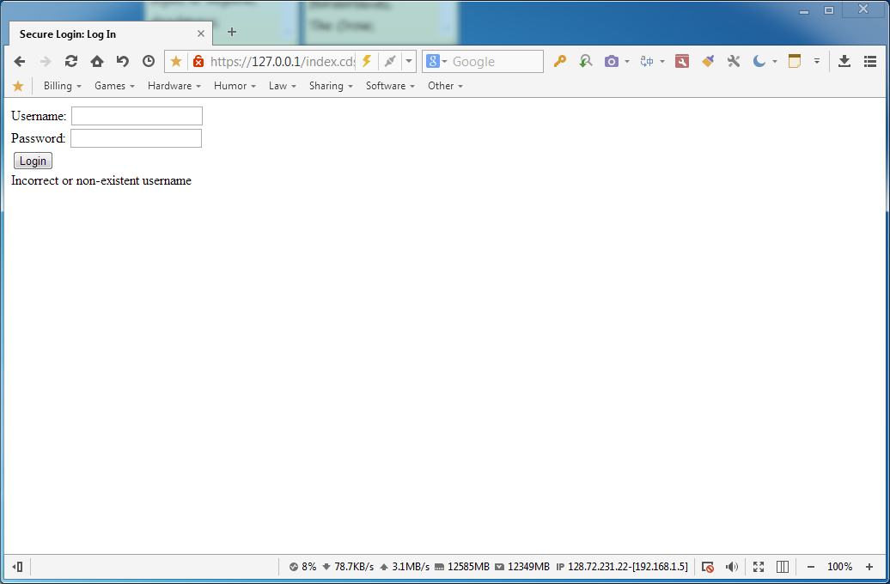
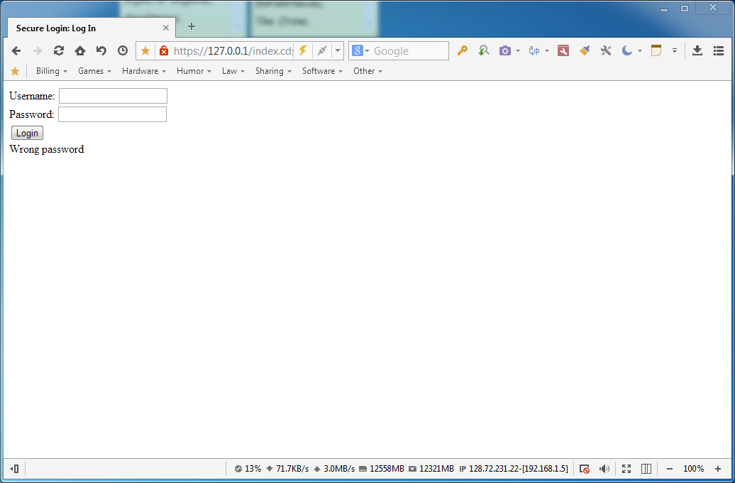
Authentication
Authentication is done using a simple login form. Login data is encrypted on POST and checked against database. In case of failures – provides appropriate message.
Incorrect logins are written into strikes table. Strikes are cleared in case of successful login or password change by another authorized user (admin, ISA, Ops, Pclient). Of required by company’s standards all login attempts may be stored as well in separate table.
Sessional data is stored in database and is also encrypted.
In case of 1st-time installation it’s required to follow a specific link to be able to create 1st admin user. Link will not work if admin user already exists for security purposes.
Back to main slide
User creation

Slide 16
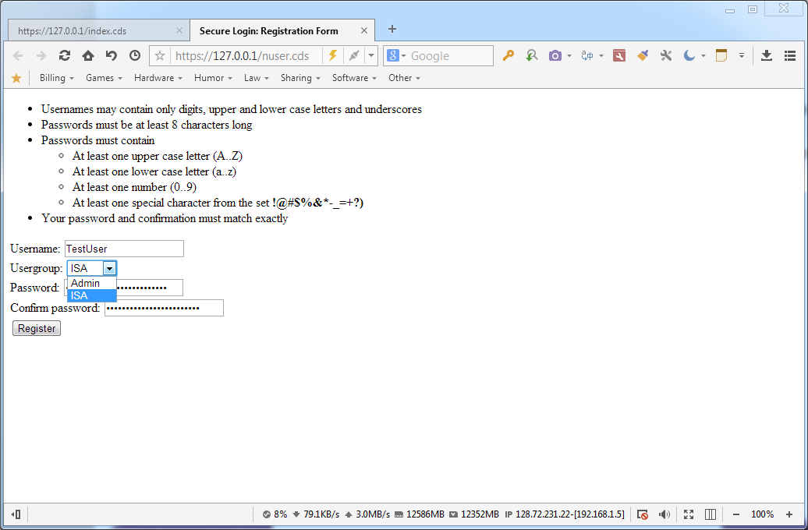
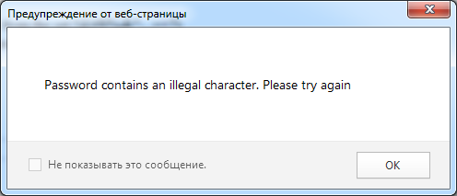
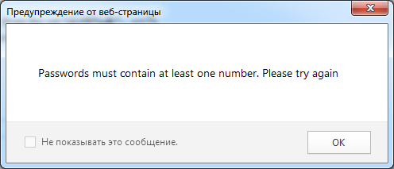
User creation
User creation can be done only by authorized user. Group available for new user depends on group of the creator as per permissions table.
In case of 1st-time installation 1st user will be created as admin user only and can be created only through a specialized page, which will redirect away in case there are admin users in database.
Back to main slide
User editing

Slide 17
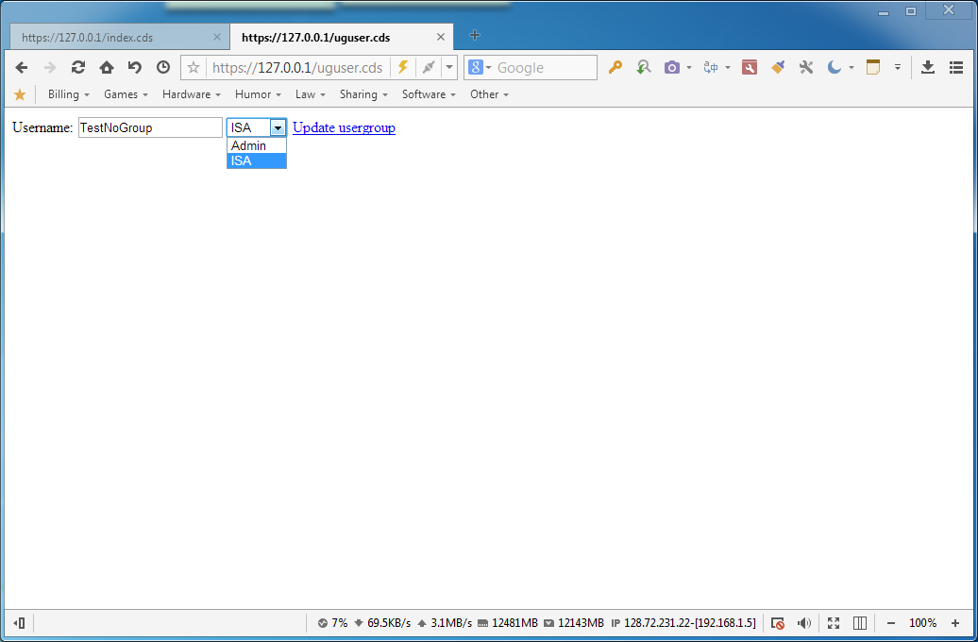
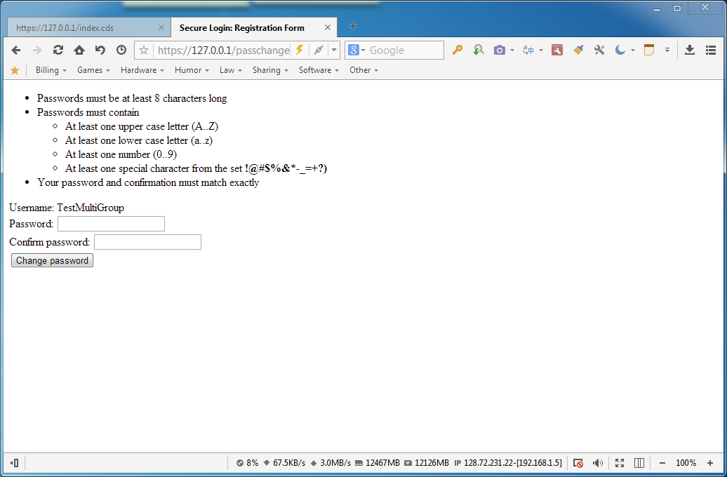
User editing
Users can be edited only by authorized users. Not all users can edit all users. For example Pclients can modify only their child users. Ops can modify all Pclients and Cclients.
Back to main slide
Access editing

Slide 18
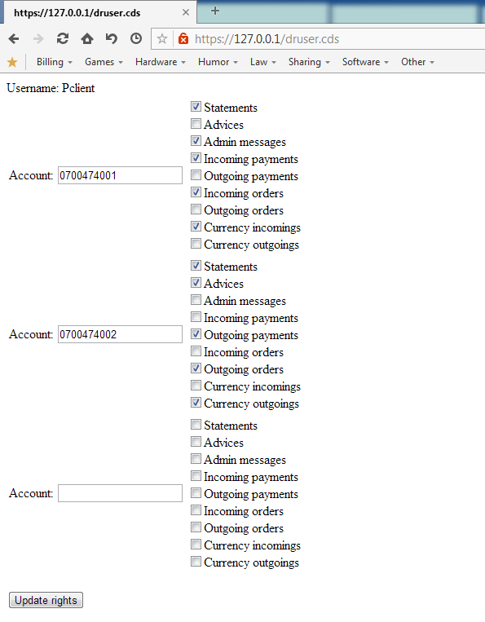
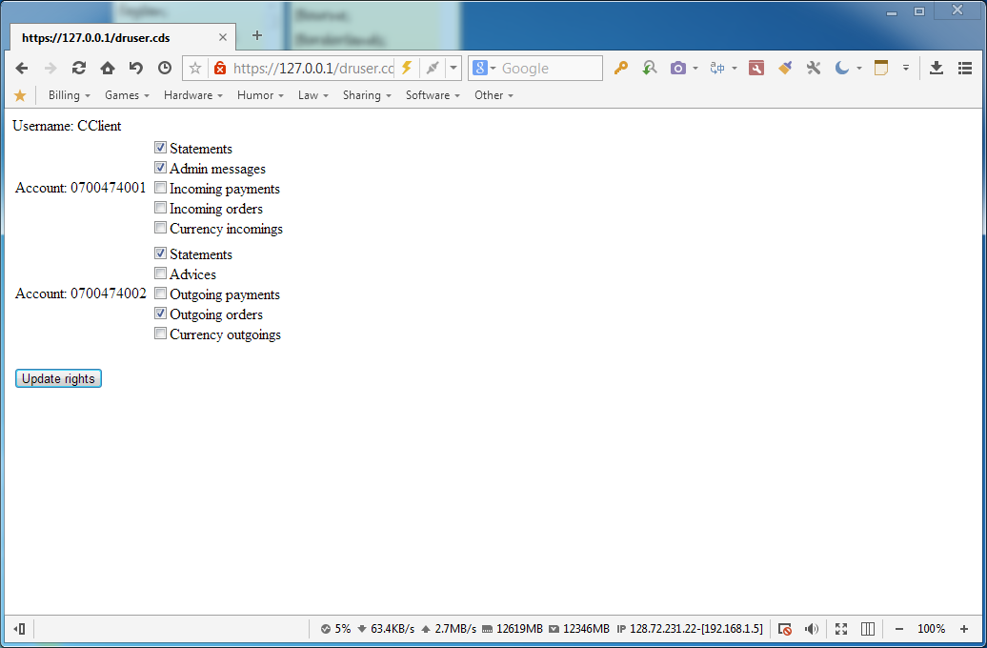
Access editing
Access permissions to documents can be edited only by Ops and by Pclients. Pclients can edit only their children, while Ops, can edit all Pclients and Cclients.
These permissions are not used by admin, ISA and Ops user groups.
Pclients can assign only those permissions that were previously assigned to them.
Permissions are stored in database as encrypted and protected JSON array for easier management, scalability and extensibility.
Ops screen
Pclient screen
Back to main slide
User monitoring

Slide 19
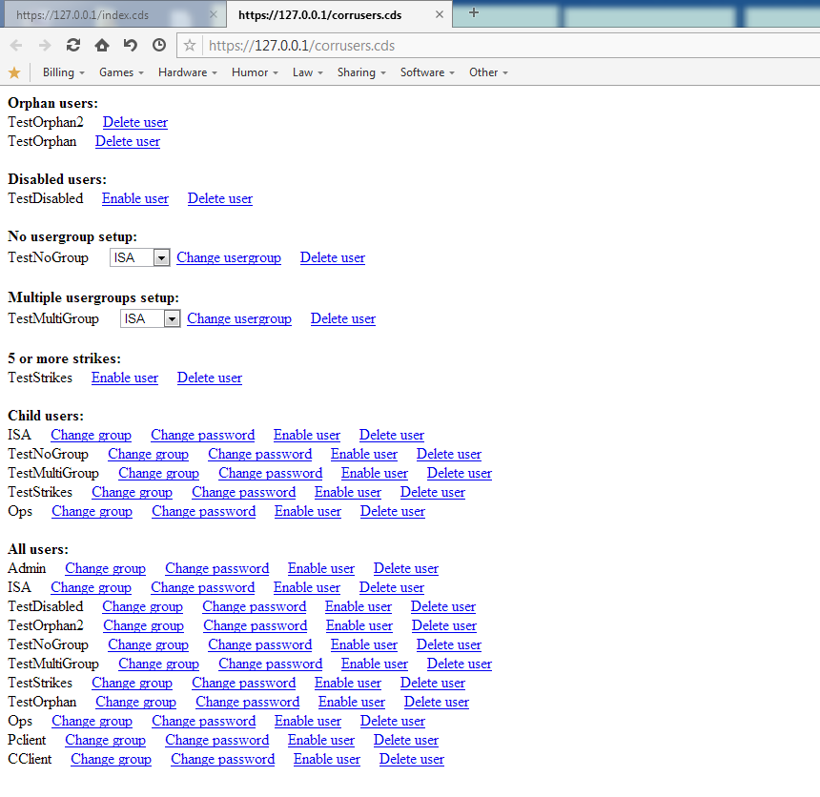
User monitoring
Users, except for Cclient, have a monitoring utility, that allows them to see users in specific statuses and issue actions on them. Screenshot shows screen of admin user.
Back to main slide
Document generation

Slide 20
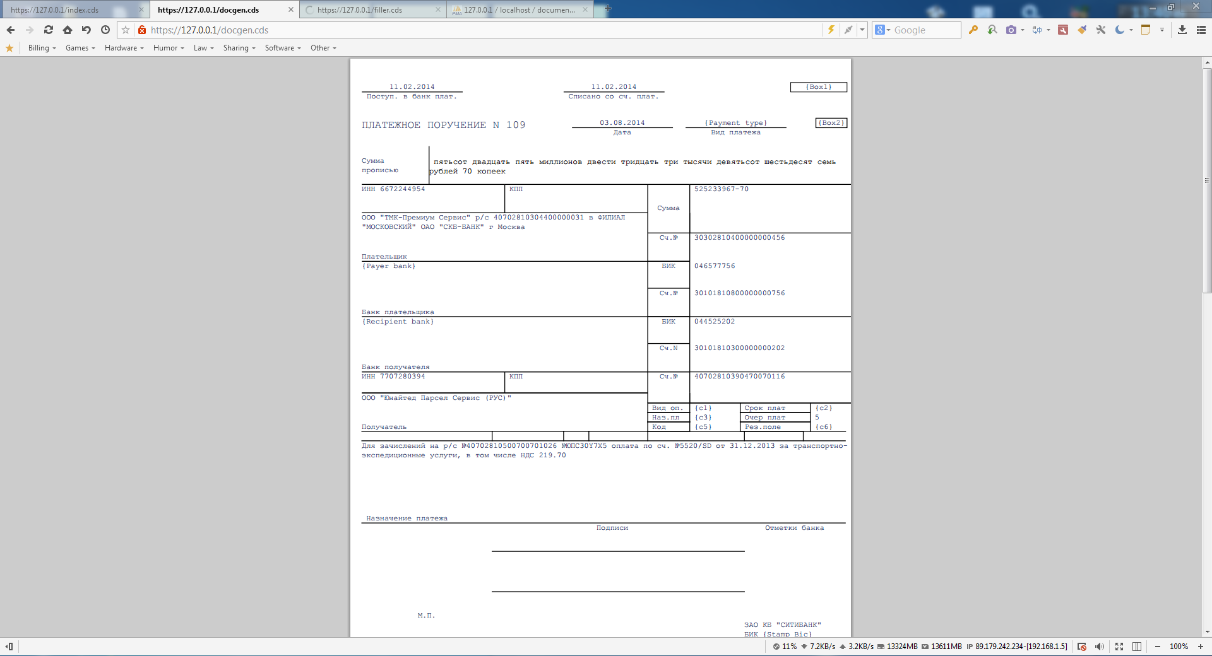
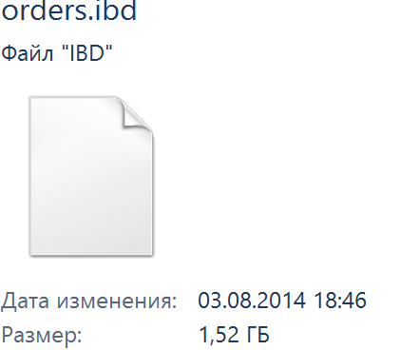
Document generation
Documents are generated dynamically and provided to web-browser. Note, that browser should be able to show .pdf documents inline. If it’s possible, browser should try to start download of a generated file, but in some browsers that may fail. For that an option to provide files as links will be implemented in future. Resulting document is signed by test signature and encrypted for extra protection as per PDF specifications
Notice: PoC version generates documents indiscriminately for the client requesting them filtering only by hardcoded account number (the one set up for Pclient and Cclient by default). Filtering should be implemented for actual production.
Notice: Some fields are not populated, because of unclear population logic or logic not integrated yet.
Notice: For showcase purposes (dynamic generation) sum of the deals is generated randomly, instead of being taken from database directly. Field “Дата” is taken as current system date. Other fields are static and taken from database.
Large file statistics:
File with ~1000 pages is generated in ~3 minutes. Size of the file is ~4 Mbs (compared to up to ~50 Mbs in some alternative generation systems, which is by ~92% smaller).
Database statistics:
Almost 2 million of rows. Non-indexed.
For 12 years with assumption of 100000 documents daily around 500 GBs will be required (100000*365*12/1000000=438 GBs with round up of 1000000 documents to 1 GB)
Limitation: can’t be sent inline or for direct download. Should be saved on server first and then download link should be provided.
For research: exact amount of pages preventing inline output.
Sample of the pre-generated document attached.
Back to main slide
Future features

Slide 21
List of suggested updates
Pagination on user list (separate for each user block, use jQuery)
Use jQuery to reduce extra page loads, where possible and secure
Show grandchildren in user list (collapsible)
Option to reassign parent ID
Option to disable user
Option to remove parent with all children and grandchildren
Document access for Ops
Message system (or mini-forum even)
Mailing system (integrated with message system)
Log viewer for admin\ISA (with some enhancements)
Option to mark user for password change
“Forgot password” system for users
OTP system (mail and\or mobile)
Ability to modify grandchildren
Update grandchildren access on parent access update
GUI improvements (accept “Enter”, where possible; “Return” button, where required; actual design [css, graphics, .etc])
Other types of documents
Filtering for document generator
Dated templates (in case of legal changes)
Global settings on database level, where appropriate and secure. With GUI to change them (with authorization)
Authorization system for user changes
Further security enhancements if and where possible
Statistics
Document upload feature
Customization for users
Visualization of digital signature for pdf pages (like a stamp)
Integration of BIC and other related libraries
Handling of missing or outdated bank details (KPP, INN, BIC, .etc)
Either API or a lightweight application to download\upload files without need to use the Web GUI (useful for automation on client side). Application to be considered potentially more secure and versatile
Back to main slide
Online sample

Slide 22
Online sample
Sample site can be accessed online on https://simbiat.ru
Notice: due to site currently being hosted on a local consumer workstation, to ensure 100% accessibility of the online sample, you can request the extra up-time by sending mail to simbiat@bk.ru
Login details:
Relevant workstation specs:
Role | Username | Password
Administrator | Admin | Admin123!@
IS administrator | ISA | Isa123!@
Citi operator | Ops | Ops123!@
Client administrator | Pclient | Pclient123!@
Client user | Cclient | Cclient123!@
Component | Model
Motherboard | Asrock Z77 Extreme 4-M
CPU | Intel Core-i5 2500 (3.30 GHrz)
RAM | Corsair CMZ16GX3M4A2400C10 (16 Gbs)
HDD | Samsung SSD 840 EVO 256 Gbs
Network | Integrated
Back to main slide
End

Slide 23
Overall benefits
Faster (or even online) electronics documents deliverance
Flexible client-oriented environment
Centralized and standardized system(s), thus reduced support costs
Easier maintenance (reduced costs)
Flexible scalability
Better technological image (even with Web 2.0 specifications, if required)
Opportunities for extra payable services (seamless integration)
Time savings
Overall stability
Green
Ability to use this system on any branch both for corporate and consumer clients
Possibility to sunset some of local systems\applications (reduced costs)
Closer communication with clients (including statistics gathering)
Costs estimation (done by 3rd party)
Web-system development and integration of such scale and functionality as suggested: from ~2 mln RUB to ~5 mln RUB (depending on selected functionality, includes testing and implementation). Support: from ~30000 RUB per month (depending on functionality, does not include further development, includes bug fixes)
© Proof of Concept sample and presentation prepared by Kustov Dmitry

